Slide 1
Moments
Dr. Jacob Moore
Associate Professor of Engineering
Penn State Mont Alto

Slide 2
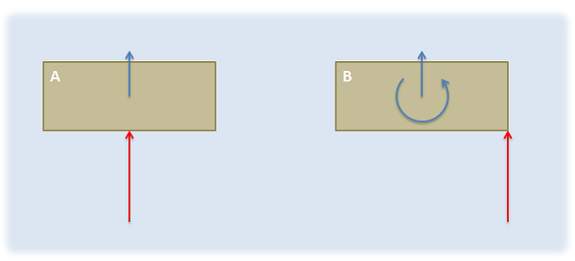
Moments
A moment of a force is the tendency of that force to cause a rotation of a body in the form of an angular acceleration.

Slide 3

Pure Moments
In many cases, we will apply a set of forces, called a couple, that will exert a moment without exerting a net force. This is called a pure moment.
Many devices, such as this electric screwdriver, can exert a pure moment.

Slide 4
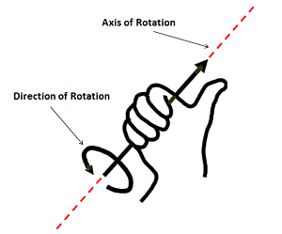
Moments as Vectors
Just as forces have both a magnitude and a direction, moments have both a magnitude and a direction.
The magnitude of the moment is related to the degree to which the force would cause angular accelerations about a given point or axis.
Measured in units of force x distance (Nm or ft lbs)
The direction of the moment vector represents the axis the force would cause the body to rotate around.
With positive and negative moments representing counter-clockwise and clockwise (respectively) potential rotation about that axis

Slide 5
Taking the Moment About a Point
When calculating moments, we need to choose a point we are taking the moment about. Both the magnitude and direction of a force will depend upon the point we pick.
Direction for a moment in two dimensions is always just going to be counterclockwise (positive) or clockwise (negative) and we can add or subtract them as scalar values.
A
C
B

Slide 6
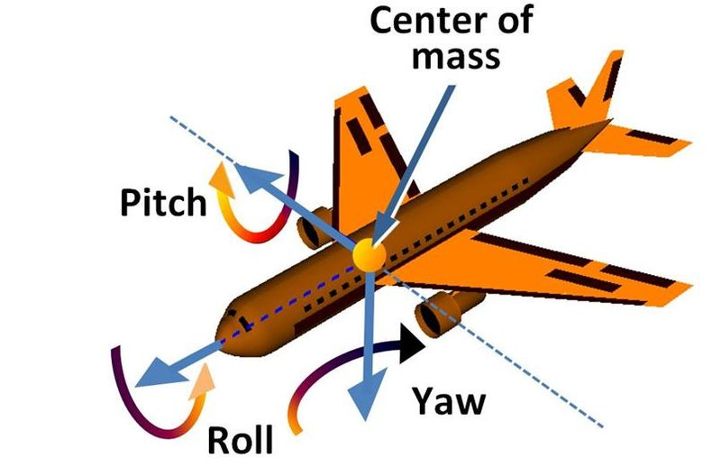
Moments in 3D
In three dimensions, the magnitude will stay the same, but now the direction is more complex.
A moment can now be applied about any axis, so we need to add or subtract them as vectors.

Slide 7
Thanks for Watching
See other engineering mechanics videos and access the full tool at…

